Slide 1
FrontEnd Training - I
HTML
Abraxas Informatik AG
Mehmet Dogan

Slide 2
Über mich
Software Engineer seit 2006
Web-Enthusiast seit 2002
Seit 2010 in Abraxas (PIE-GPI, CCC, Mobile, WS)
BSc Computer Sciences, DEU, Izmir/Türkei
MSc Sogtware Engineering, University of Liverpool, UK
Twitter : @dom_ch
Github: domch

Slide 3
Structure
Intro
History
Evolution of the web
Browser
Tools
HTML
Structure
Tags
Attributes
Semantic Web
Layout
Other Goodies
Questions

Slide 4
Intro

Slide 5
Web sites
Structured text documents
Navigable documents
Enriched content with media (Pictures, Video, etc...)
can be tied together with links.
The content can be indexed and searched (SEO).
1.3+ Billion Web sites online
Consists: HTML, CSS, JS, Fonts, Pictures, Video, 3D, PDF, SVG, Streaming,...
Documents from Internet

Slide 6
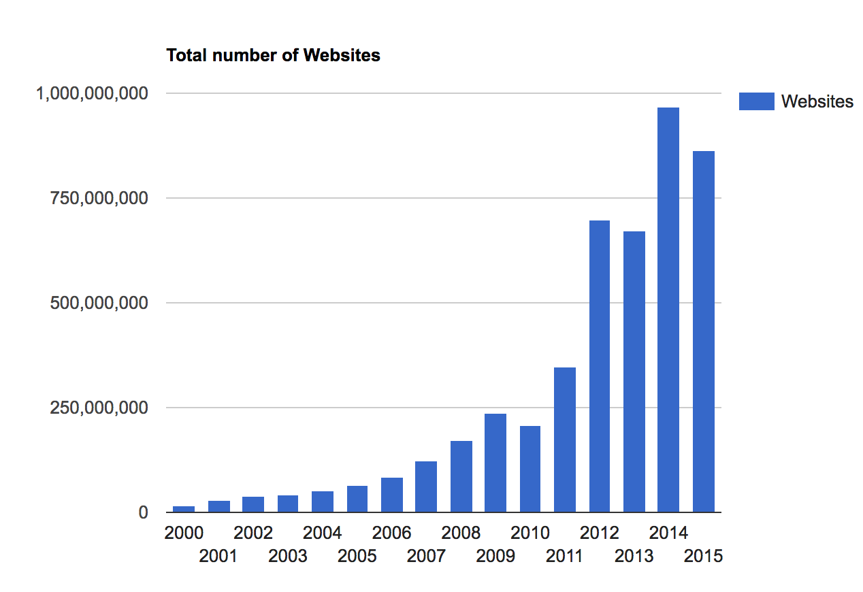
The number of websites over years
http://www.internetlivestats.com/total-number-of-websites/

Slide 7
HTML
HTML
Hypertext Markup Language
Language that describes the structure of a page/content
CERN
Sharing information among scientists
Unification project for information exchange is started
1992
1. specification HTML (Tim Berners Lee)
SOLID, a decentralised web platform (https://solid.inrupt.com/how-it-works)
Current
HTML5 (5.2)
W3C and WHATWG standardize HTML further.
Only data is formatted (zengarden!)
The Internet document whose content is defined or structured with a markup language.

Slide 8
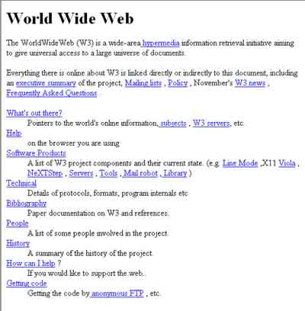
Tim Berners Lees first HTML Seite.
Source: designer-info.com

Slide 9
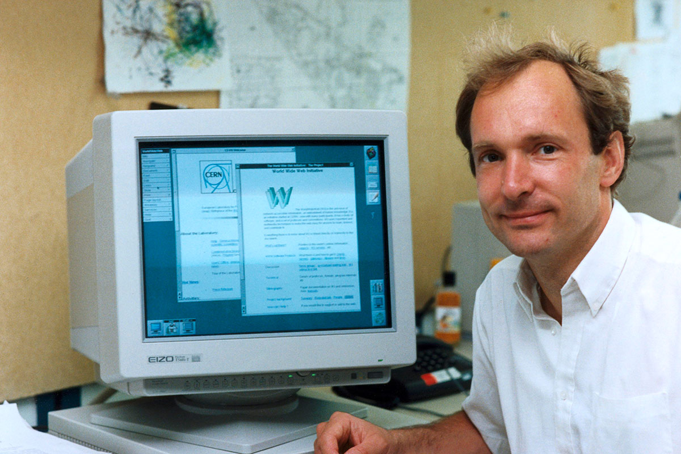
Tim Berners Lee
Source: Engramme

Slide 10
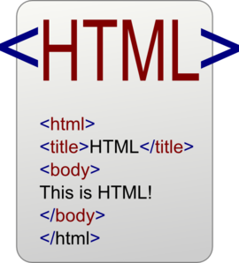

An HTML document has a very simple initial structure. But it can be structured very complex.
Source: Clicker, Read Rom NOLA

Slide 11
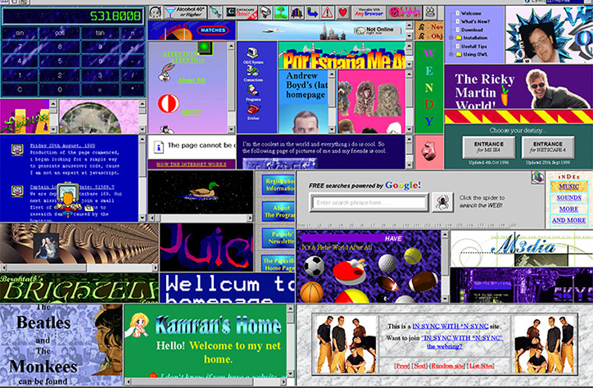
Then at some point in 90 years, end users will begin to design.

Slide 12

DOT COM Bubble
Source: https://www.seatrade-maritime.com
Notes:
who funded dot-com companies and lost 90% of his net worth when the bubble burst, said about the dot-com bubble:

Slide 13
Browser
A desktop program that allows a user to navigate between the web pages.
Chrome, Internet Explorer (IE, Edge), Firefox (FF), Safari, Opera…
The browsers are developed by the major internet companies or organizations.
Google -> Chrome
Mozilla -> Firefox
Apple -> Safari
Microsoft -> IE, Edge
Browser Wars
A browser can understand and interpret HTML, CSS, JS.
The window to the web
Notes:
Mosaic, Links, Data/Dokument sharing
Mail
GOPHER (CLI interface, indexes, structured)

Slide 14

Five well-known Browsers
http://www.evolutionoftheweb.com/

Slide 15
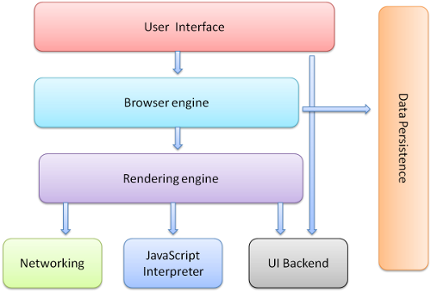
Browser Internal Components
Source: htmlrocks.com

Slide 16
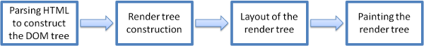
The main browser rendering flow
Source: htmlrocks.com
Notes:
The rendering engine will start parsing the HTML document and convert elements to DOM nodes in a tree called the "content tree". The engine will parse the style data, both in external CSS files and in style elements. Styling information together with visual instructions in the HTML will be used to create another tree: the render tree.
The render tree contains rectangles with visual attributes like color and dimensions. The rectangles are in the right order to be displayed on the screen.
After the construction of the render tree it goes through a "layout" process. This means giving each node the exact coordinates where it should appear on the screen. The next stage is painting–the render tree will be traversed and each node will be painted using the UI backend layer.
A gradual process

Slide 17
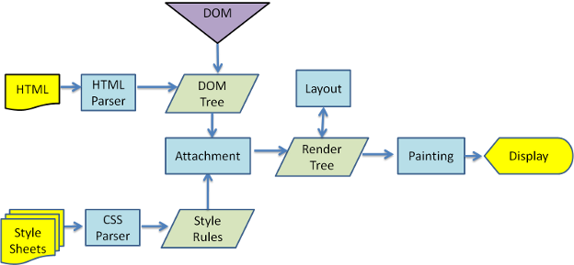
Webkit html document parsing
Source: htmlrocks.com

Slide 18
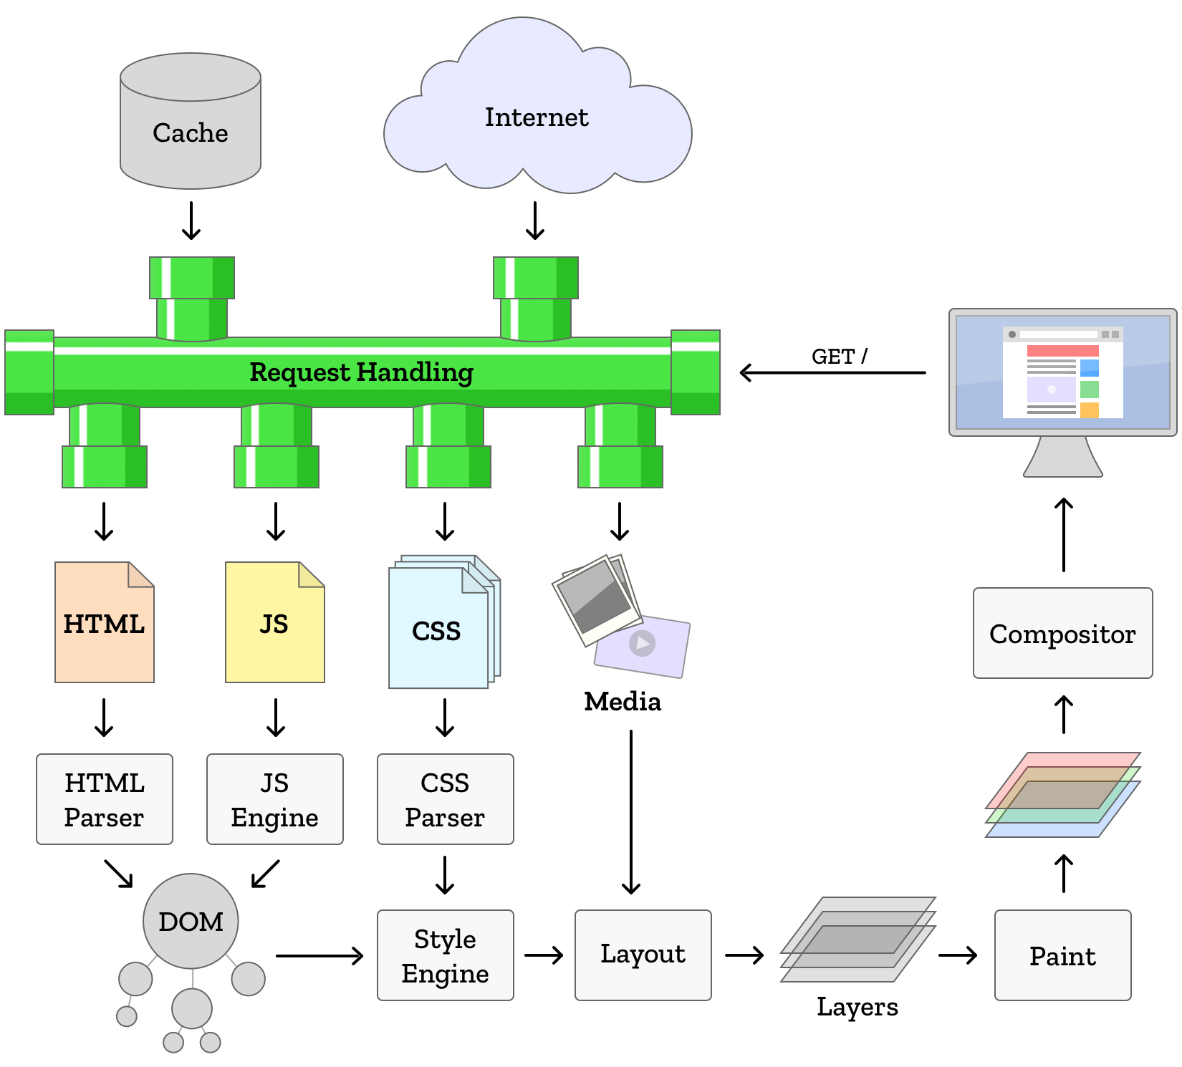

Slide 19
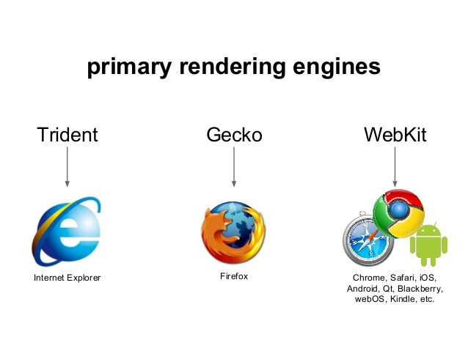
Which browser is using which layout engine?
Notes:
Opera → Webkit
Chome → Blink

Slide 20

Browser Wars
https://www.youtube.com/watch?v=LF6y3C6u7b8
Notes:
The First Browser War was Microsoft's Internet Explorer against Netscape's Navigator during the late 1990s (1996 - 2001). Explorer (2-4), Netscape
The second was at the beginning of 2004 -

Slide 21
Tools
Any text editor
IntelliJ or Visual Studio Code
Chrome Dev Tools

Slide 22
Dev Tools
Chrome DevTools Chrome DevTools is a set of web developer tools built directly into the Google Chrome browser. DevTools can help you edit pages on-the-fly and diagnose problems quickly, which ultimately helps you build better websites, faster.
Notes:
Level of participiants

Slide 23
HTML

Slide 24
HTML
Tags

Slide 25

Tags
Tags are commands
Every tag is interpreted by the browser
Interpreted tags assemble a view, browser page.
Every tag has a meaning/duty.
Classification
Tags for Structure
Tags for document content
Tags for document layout
Tags for Input, server communication
HTML Commands

Slide 26
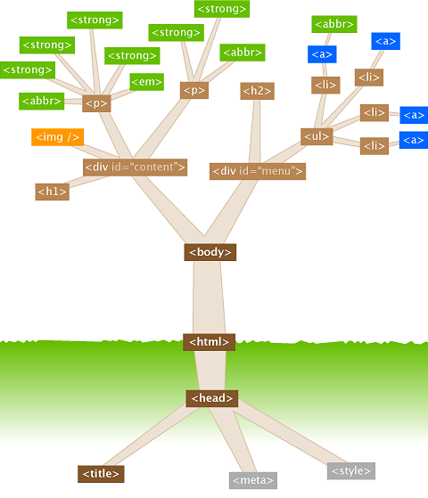
Document Object Model = DOM

Slide 27
Tags
For Structure
<!DOCTYPE html>
Document type defintion → html latest version HTML5
html
Defines the whole HTML ist.
head
<title></title>
<meta/>
<link></link>
Element for document linking, such as external CSS files
<script></script>
Javascript code / files can be imported
body
Visible part of the page
Envelope

Slide 28
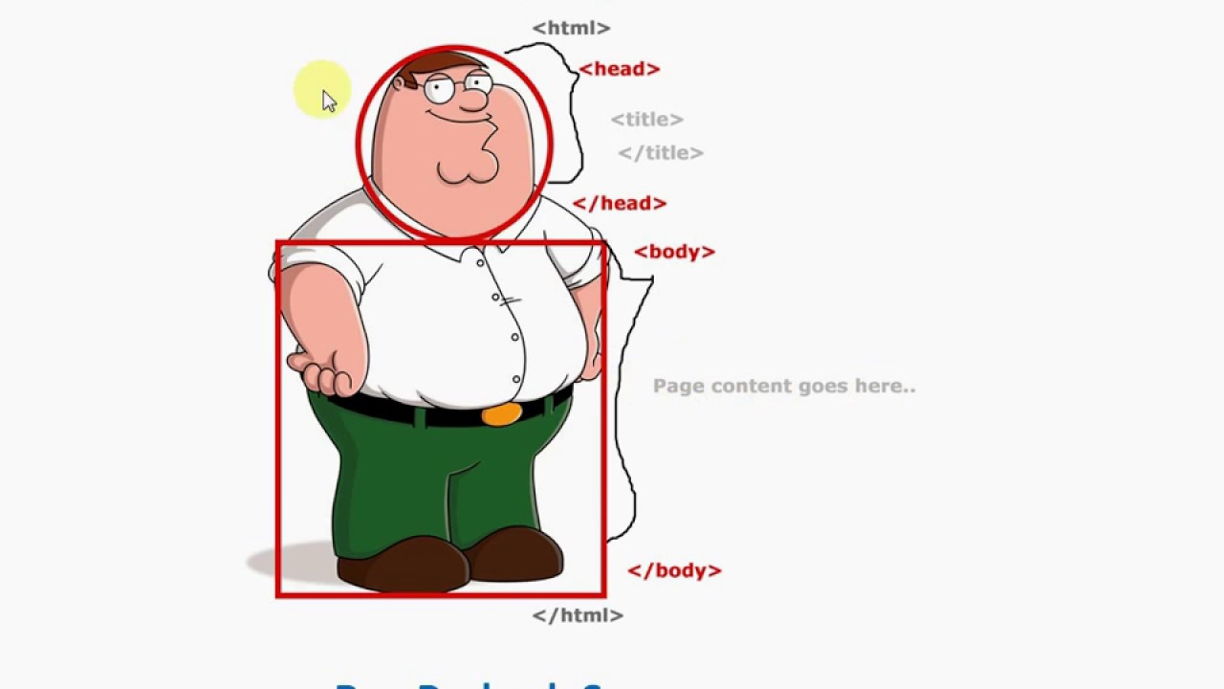
:)

Slide 29
<!DOCTYPE html> <html lang="en"> <head> <meta charset="utf-8"> <title>title</title> <link rel="stylesheet" href="style.css"> <script src="script.js"></script> </head> <body> <!-- page content --> </body> </html>
A small HTML Document

Slide 30
Tip!
Use the charset and title information in the first 1000 bytes. Browser engines try to sniff the char encoding by analysing first part of the content.

Slide 31
Tip!
You can ignore the entire structure and just start with the html content. The browser complements your HTML with its defaults.
But be aware of it: Your HTML does not validate on all browsers.

Slide 32
<p> this is a lonely tag </p>
A really small HTML Document

Slide 33
DOCTYPE
All HTML need to have a DOCTYPE declared.
The DOCTYPE is not actually an element or HTML tag.
The doctype is used for two things, by different kinds of software:
Web browsers use it to determine which rendering mode they should use.
Markup validators look at the doctype to determine which rules they should check the document against (more on that later as well).
Standard mode vs quirks mode
Notes:
It lets the browser know how the document should be interpreted, by indicating what version or standard of HTML (or other markup language) is being used.
they use “Quirks mode”, which is more backwards compatible with old practices and old browsers

Slide 34
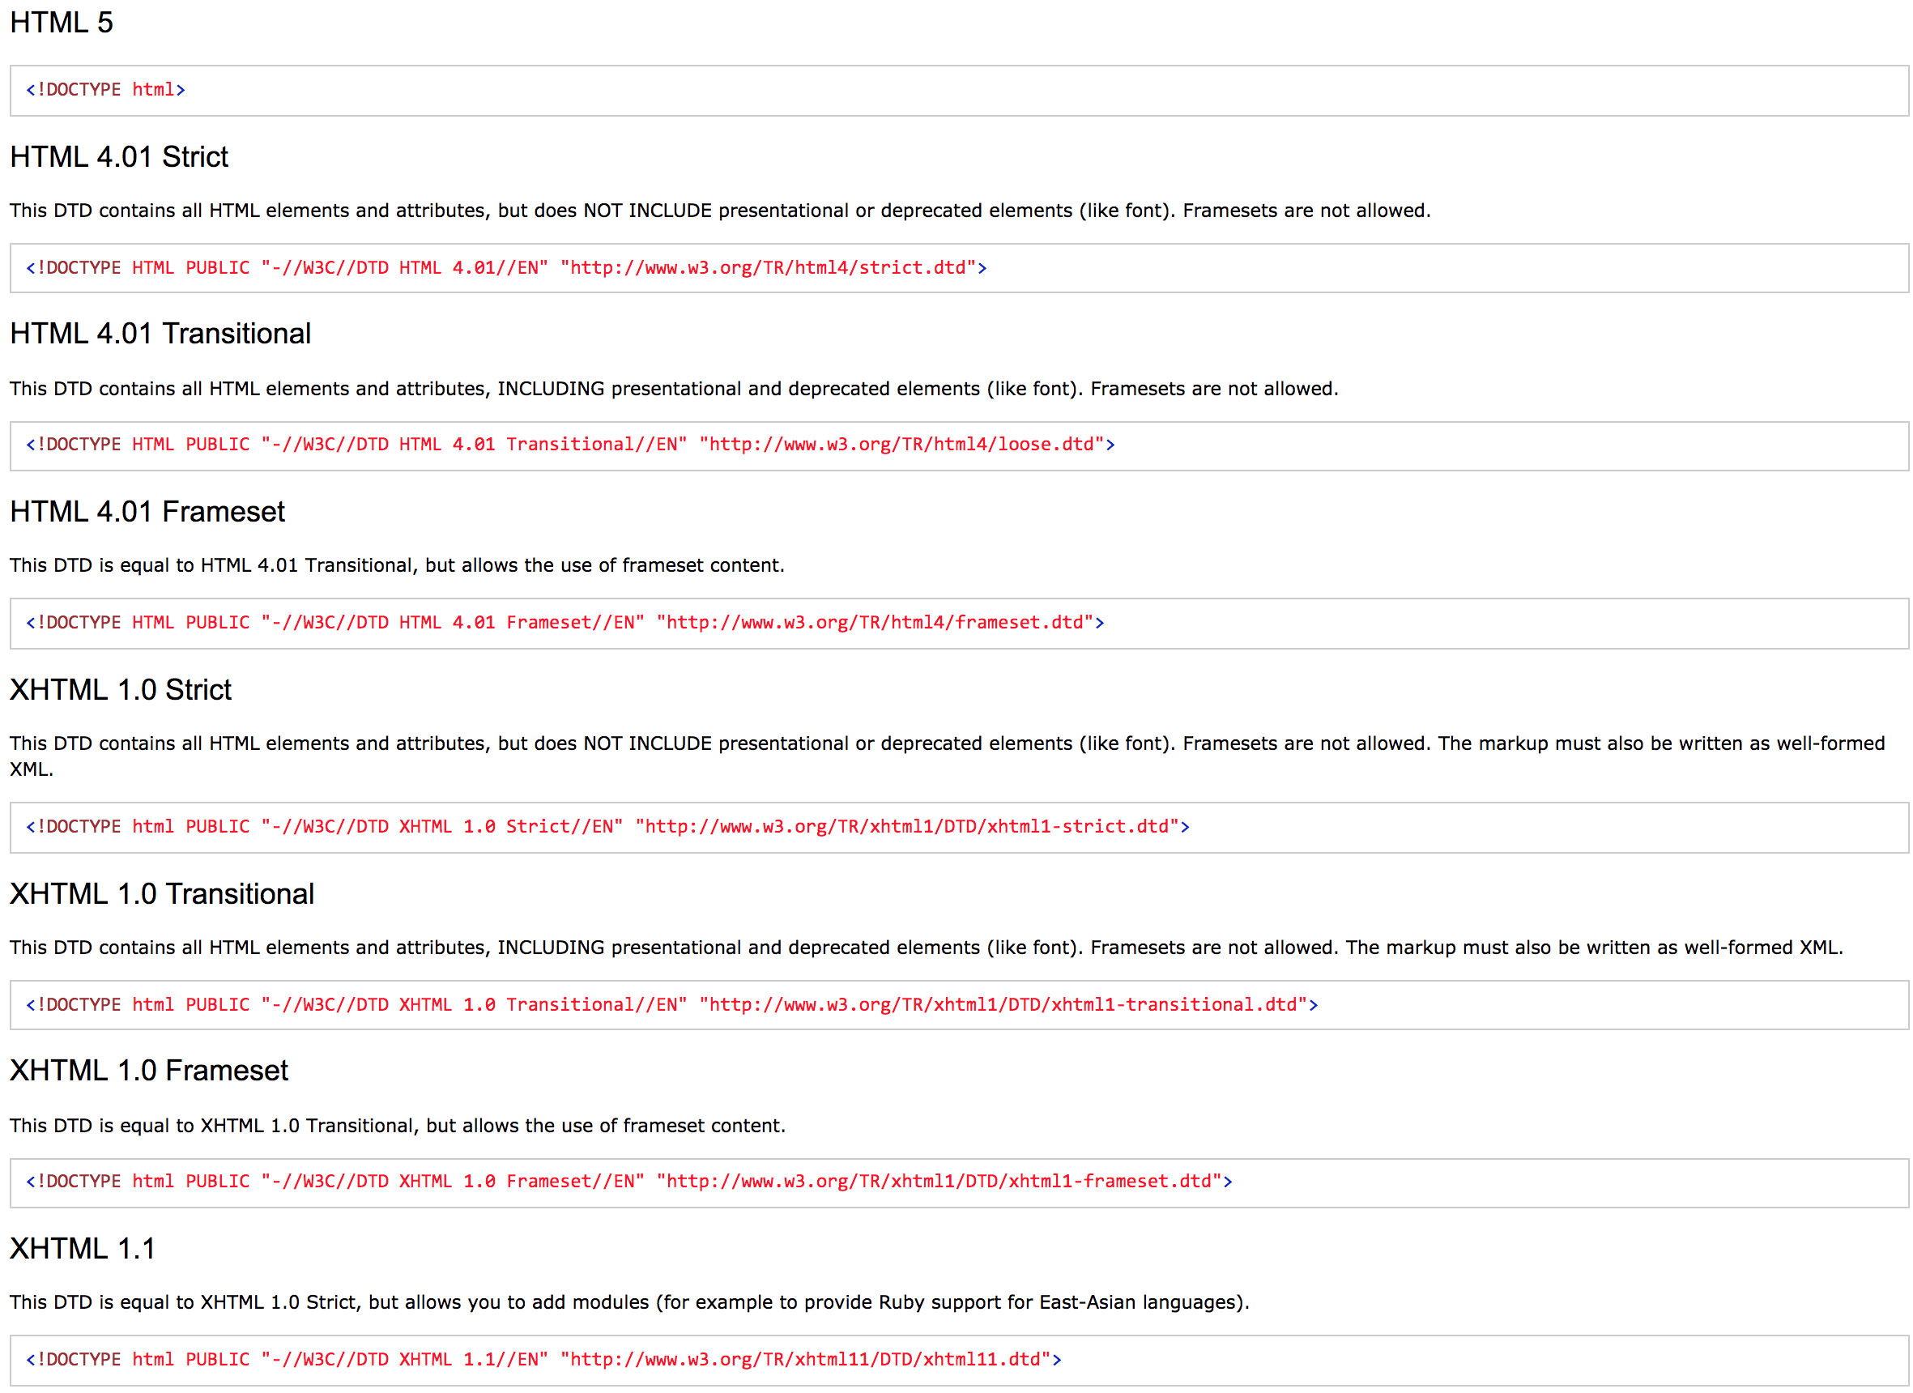
Doctype declarations
Source: w3schools.com

Slide 35
Tip!
Problem
On some systems, there can be set some headers which could cause browser selects automatically an unexpected doctype. And this could cause that the web site is rendered differently as expected.
Solution
Use explicit doctype and additionally tell the browser via meta data definition in head which versions are targeted
<meta http-equiv="X-UA-Compatible" content="IE=edge,chrome=1">

Slide 36
Tip!
Take a look on the following web page which shows a rich html start template.
https://html5boilerplate.com/

Slide 37
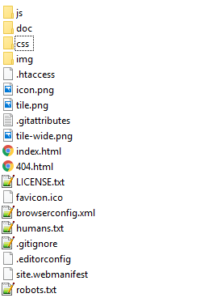
HTML5 Boilerplate Structure

Slide 38
Meta Data
The head of an HTML document is the part that is not displayed in the web browser when the page is loaded. It contains information such as the page <title>, links to CSS, links to custom favicons, and other metadata
Data about the HTML
The author
Important keywords that describe the document
Social media handlers (twitter)
Geolocation infos (open graph)

Slide 39
...
<meta charset="utf-8">
<meta name="description" content="Free Web tutorials">
<meta name="keywords" content="HTML,CSS,XML,JavaScript">
<meta name="author" content="John Doe">
<meta name="copyright" content="Copyright owner" />
<meta name="viewport" content="width=device-width, initial-scale=1.0">
<meta name="robots" content="noindex" />
<meta name="geo.position" content="latitude; longitude">
<meta name="geo.placename" content="Place Name">
<meta name="geo.region" content="Country Subdivision Code">
Spezielle Metatags für: Twitter, Facebook, Microsoft, Apple, Android, etc...
Gives Information on the HTML Document

Slide 40
Tip!
Setting the right encoding of the page can be very tricky!
Use always UTF-8, if possible!
Use the following meta data for defining encoding.
<meta charset="utf-8">
Be sure your file is created with the right encoding
Be sure your server (or any network component) has no effect on encoding.
You can set response header with the appropriate encoding, if needed

Slide 41
Tags
for Content
<h1></h1> (h2, h3, h4, h5, h6)
Element for defining Headings.
<p></p>
Element for defining Paragraphs
<b></b>, <strong></strong>
<i></i>, <em></em>
<a>
Anchor
<ul></ul>
Unordered List, Element for defining an unstructured list
<ol></ol>
Ordered List, Element for defining an structured list
<li></li>
List Item, Element for defining a list
<img>, <video>, <audio>, <embed>, <object>

Slide 42
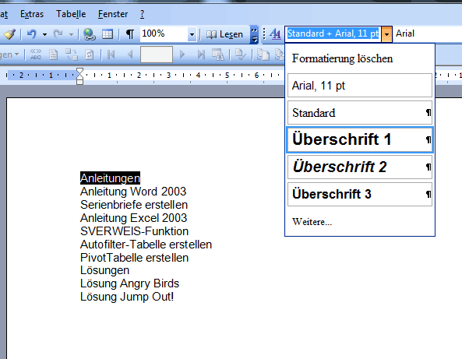
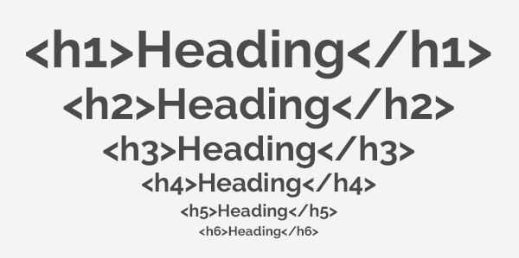
Tags for Content
Headings
<h1></h1> (h2, h3, h4, h5, h6)

Slide 43
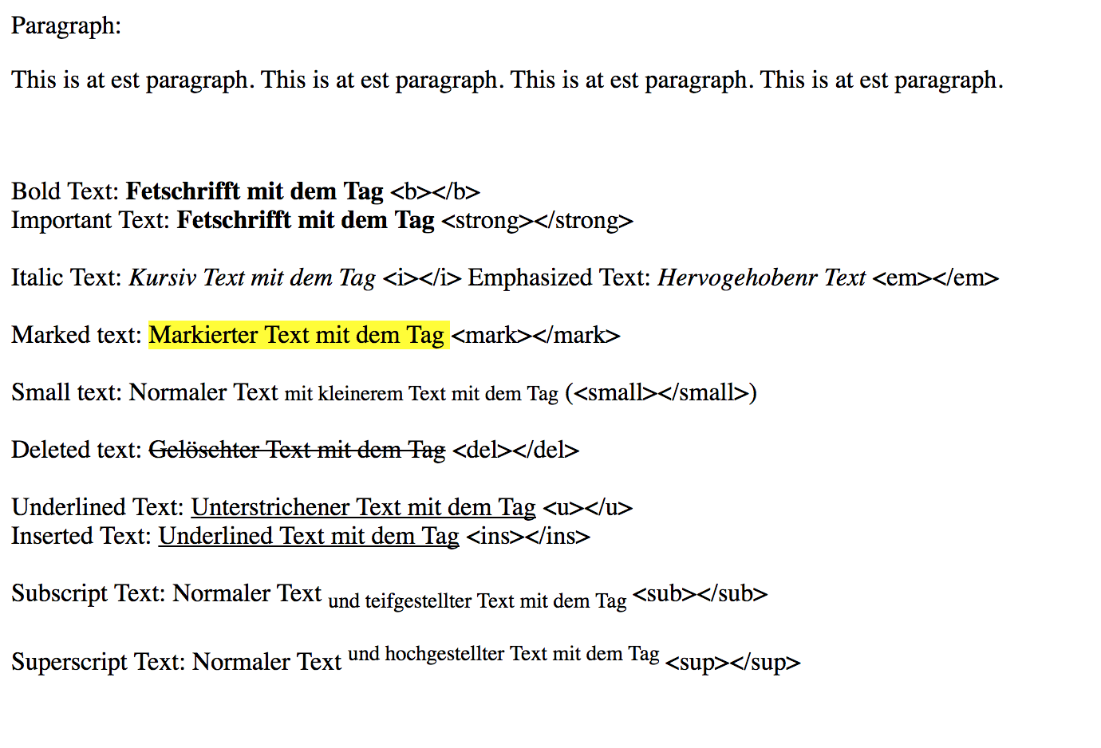
Tags for Content - I
Text formatting
Paragraph: <p></p>
Bold: <b></b>, <strong></strong>
Italic: <i></i>, <em></em>
Marked text: <mark></mark>
TEST Small text: <small></small>
Deleted text: <del></del>
Inserted text: <ins></ins>, <u></u>
TEST_{Subscript text}: <sub></sub>
TEST ^{Superscript text}: <sup></sup>

Slide 44
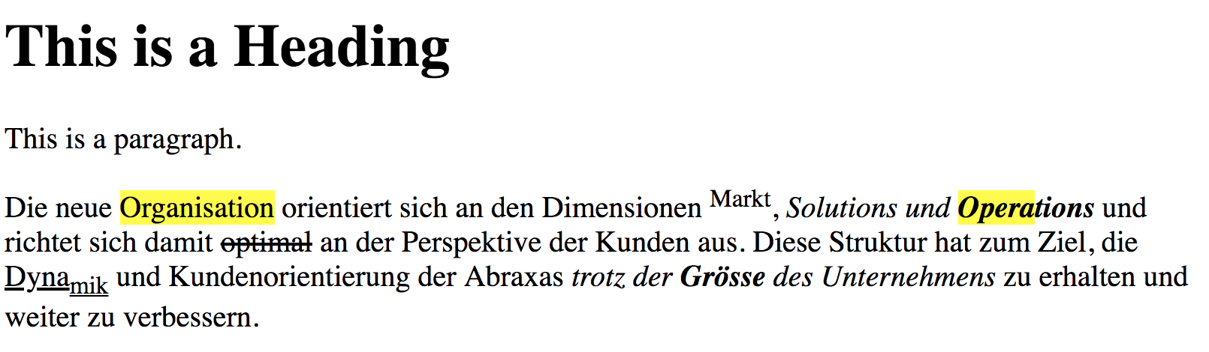
let’s try it
https://www.abraxas.ch/de/ueber-uns/organisation/ueberblick
Notes:
<!DOCTYPE html>
<html>
<head>
<title>Page Title</title>
</head>
<body>
<h1>This is a Heading</h1>
<p>This is a paragraph.</p>
<p>Die neue <mark>Organisation</mark> orientiert sich an den Dimensionen <sup>Markt</sup>, <em>Solutions und <strong><mark>Opera</mark>tions</strong></em> und richtet sich damit <del>optimal</del> an der Perspektive der Kunden aus. Diese Struktur hat zum Ziel, die <ins>Dyna<sub>mik</sub></ins> und Kundenorientierung der Abraxas <em>trotz der <strong>Grösse</strong> des Unternehmens</em> zu erhalten und weiter zu verbessern.</p>
</body>
</html>

Slide 45
<!DOCTYPE html> <html lang="de-CH"> <head> <meta charset="UTF-8" /> <title>Page Title</title> </head> <body> <h1>This is a Heading</h1> <p>This is a paragraph.</p> <p>Die neue <mark>Organisation</mark> orientiert sich an den Dimensionen <sup>Markt</sup>, <em>Solutions und <strong><mark>Opera</mark>tions</strong></em> und richtet sich damit <del>optimal</del> an der Perspektive der Kunden aus. Diese Struktur hat zum Ziel, die <ins>Dyna<sub>mik</sub></ins> und Kundenorientierung der Abraxas <em>trotz der <strong>Grösse</strong> des Unternehmens</em> zu erhalten und weiter zu verbessern.</p> </body> </html>
Solution

Slide 46
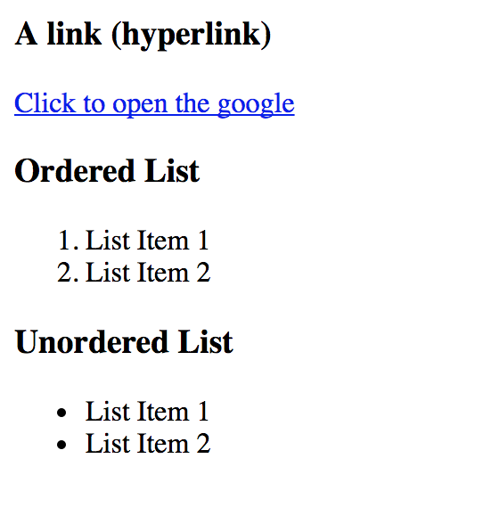
Tags for Content - II
Text formatting
Links: <a href=”Link/web adress”>display name</a>
href is an Attribute
<a href="https://google.ch" alt="Google" title="Google's Link">Click to open the google</a>
Lists:
Ordered List
<ol>
<li>List Item</li>
<li>List Item</li>
</ol>
Unordered List
<ul>
<li>List Item</li>
<li>List Item</li>
</ul>

Slide 47
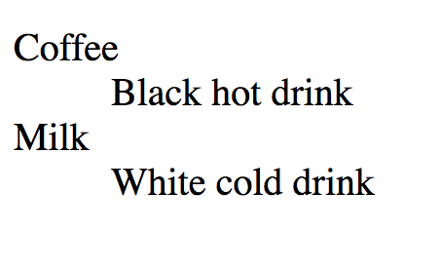
Tags for Content - II
Lists:
Definition List
<dl>
<dt>Coffee</dt>
<dd>Black hot drink</dd>
<dt>Milk</dtY
<dd>White cold drink</dd>
</dl>

Slide 48
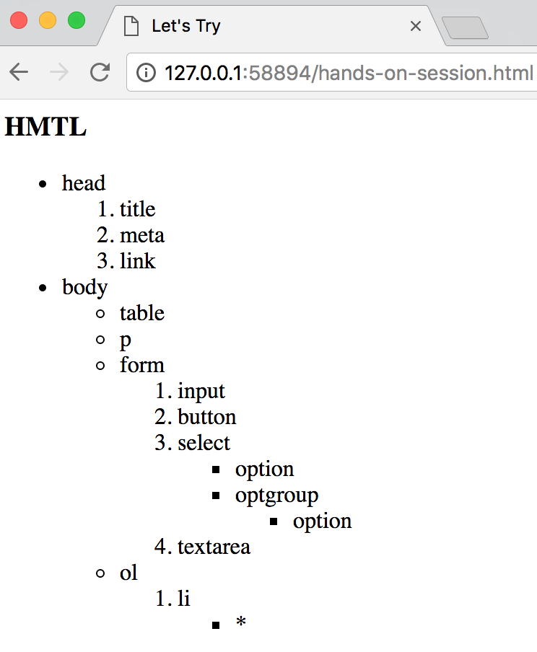
let’s try it

Slide 49
<!DOCTYPE html> <html lang="de-CH"> <head> <meta charset="UTF-8" /> <title>Lists</title> </head> <body> <h1>HTML</h1> <ul> <li>head <ol> <li>title</li> <li>meta</li> <li>link</li> </ol> </li> <li>body <ul> <li>table</li> <li>p</li> <li>form <ol> <li>input</li> <li>button</li> <li>select <ul> <li>option</li> <li>optiongroup <ul> <li>option</li> </ul> </li> </ul> </li> <li>textarea</li> </ol> </li> <li>ol <ol> <li>li <ul> <li>*</li> </ul> </li> </ol> </li> </ul> </li> </ul> </body> </html>
Solution

Slide 50
Tags for Content - III
Text formatting
pre: Maintains original format
q: Smaller, shorter quotations
blockquote: Quotations from other sources
label: Form elements are named
fieldset, legend: Form elements can be grouped
Img: Displays images
figure: Displays images more structured than img
audio: Embeds audios
video: Embeds videos
object: Embeds any kind of file (img, video, audio, pdf, word, excel, etc...)

Slide 51
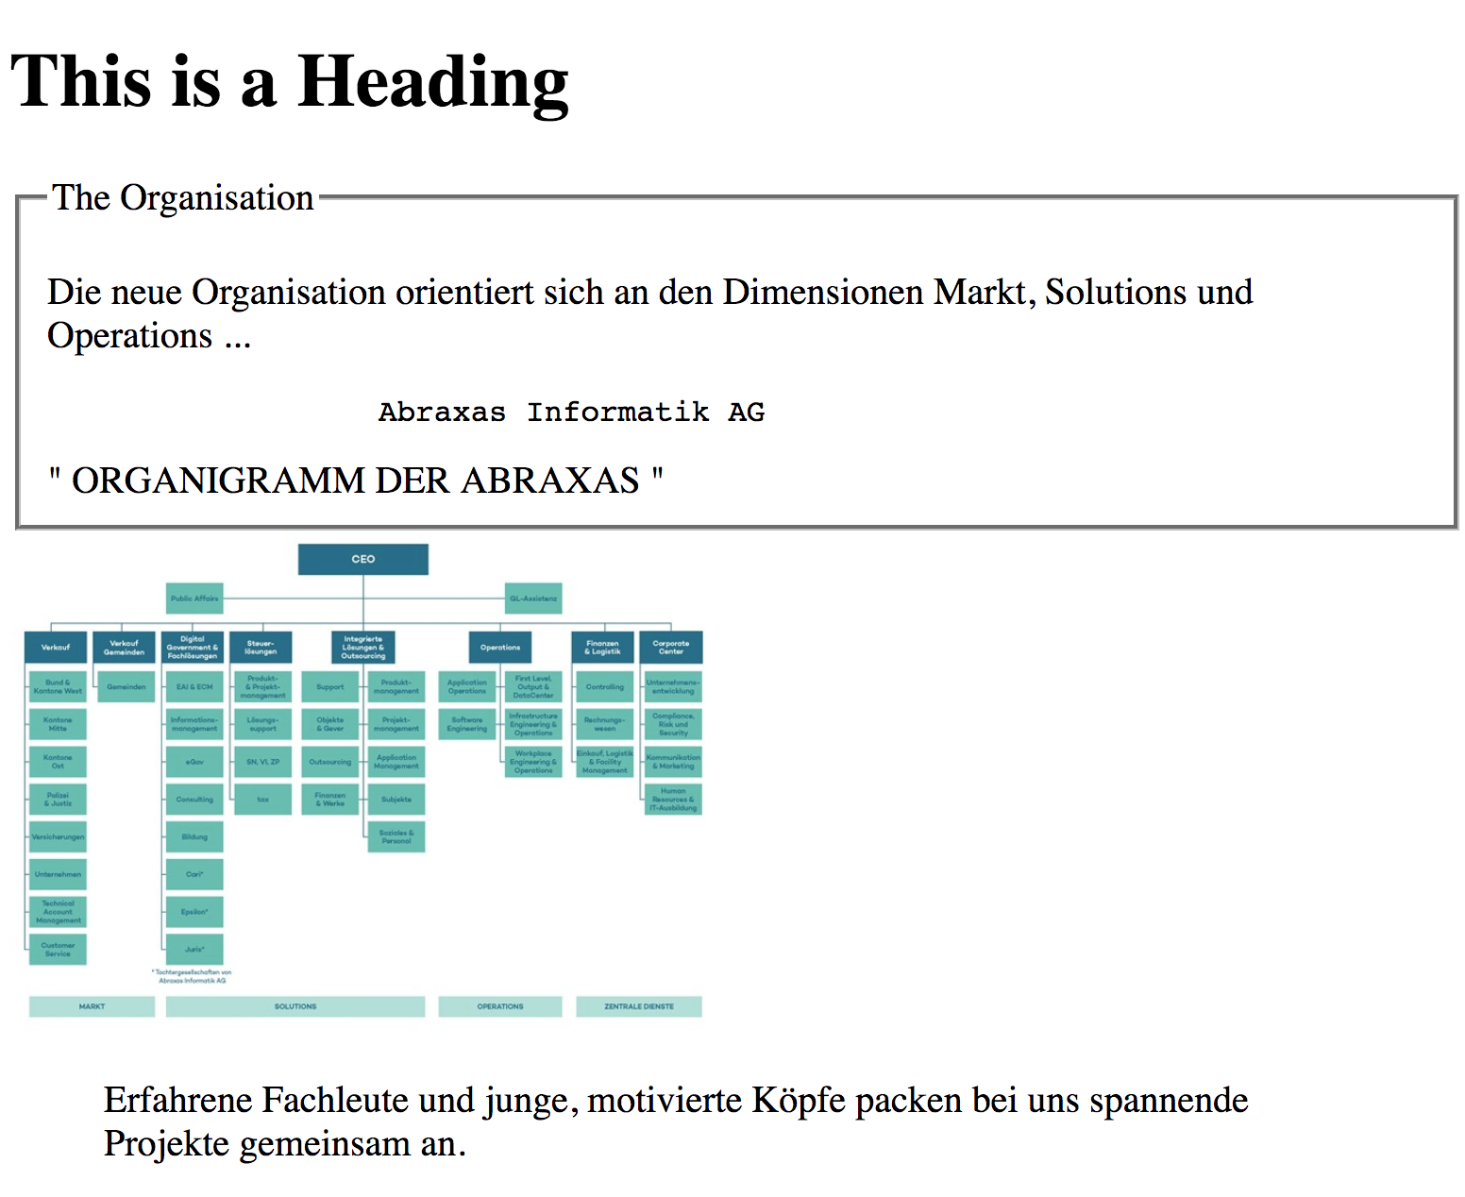
let’s try it
13
Notes:
<!DOCTYPE html>
<html>
<head>
<title>Page Title</title>
</head>
<body>
<h1>This is a Heading</h1>
<fieldset>
<legend>The Organisation</legend>
<p>
Die neue Organisation orientiert sich an den Dimensionen Markt, Solutions und Operations ...
</p>
<pre>
Abraxas Informatik AG
</pre>
<q> ORGANIGRAMM DER ABRAXAS </q>
</fieldset>
<img width="300" src="https://www.abraxas.ch/media/90001/abraxas-organigramm.jpg?anchor=center&mode=crop&width=700&rnd=131670819710000000" >
<blockquote> Erfahrene Fachleute und junge, motivierte Köpfe packen bei uns spannende Projekte gemeinsam an. </blockquote>
</body>
</html>

Slide 52
<!DOCTYPE html> <html lang="de-CH"> <head> <meta charset="UTF-8" /> <title>Page Title</title> </head> <body> <h1>This is a Heading</h1> <fieldset> <legend>The Organisation</legend> <p> Die neue Organisation orientiert sich an den Dimensionen Markt, Solutions und Operations ... </p> <pre> Abraxas Informatik AG </pre> <q> ORGANIGRAMM DER ABRAXAS </q> </fieldset> <img width="300" src="https://www.abraxas.ch/media/90001/abraxas-organigramm.jpg?anchor=center&mode=crop&width=700&rnd=131670819710000000" > <blockquote> Erfahrene Fachleute und junge, motivierte Köpfe packen bei uns spannende Projekte gemeinsam an. </blockquote> </body> </html>
Solution

Slide 53
Tags for Communication
with the Server
form
input
textarea
select
option
button

Slide 54
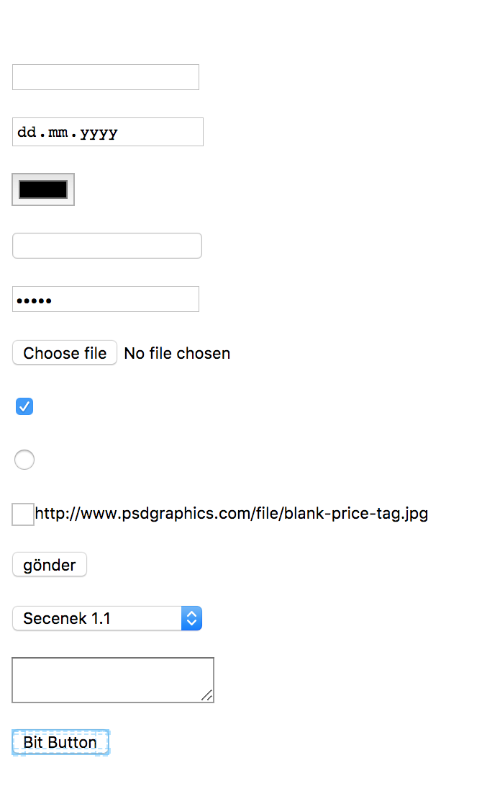
Tags for Server Forms
<form></form>
<input type=”text” name=”name” value=”club”/>
type: text, number, email, file, color, search, date, checkbox, submit, button, image, password, hidden
Placeholder, patterns, etc...
<select></select>
<optgroup></optgroup>
<option></option>
<textarea></textarea>
<button>>/button>

Slide 55
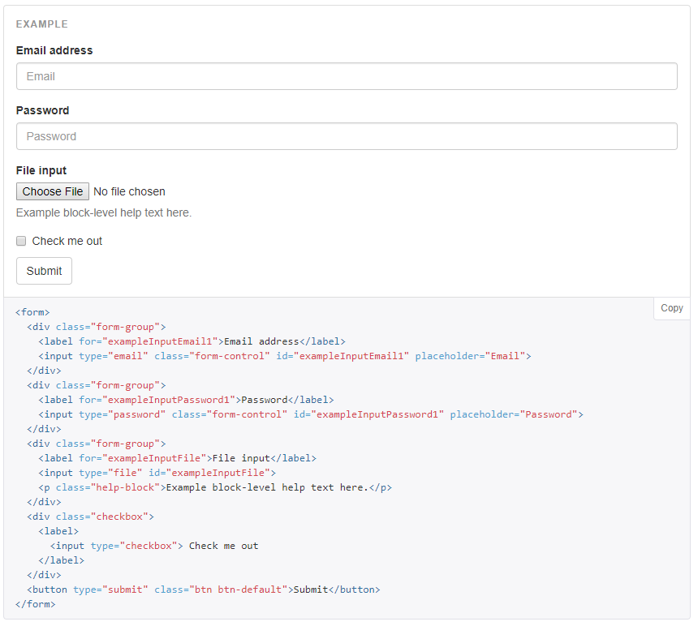
An HTML Form

Slide 56
let’s try it
Create a form for buying a car. Include following criterias:
First/Last Name
Email
Tel
Birthdate
Min/Max Budget
Color of the favorite car
Grouped marks and models
Please use the following attributes, whereas possible:
Placeholder
Patterns
Autofocus
13
Notes:
<!DOCTYPE html>
<html>
<head>
<title>Page Title</title>
</head>
<body>
<h1>This is a Heading</h1>
<fieldset>
<legend>The Organisation</legend>
<p>
Die neue Organisation orientiert sich an den Dimensionen Markt, Solutions und Operations ...
</p>
<pre>
Abraxas Informatik AG
</pre>
<q> ORGANIGRAMM DER ABRAXAS </q>
</fieldset>
<img width="300" src="https://www.abraxas.ch/media/90001/abraxas-organigramm.jpg?anchor=center&mode=crop&width=700&rnd=131670819710000000" >
<blockquote> Erfahrene Fachleute und junge, motivierte Köpfe packen bei uns spannende Projekte gemeinsam an. </blockquote>
</body>
</html>

Slide 57
<!DOCTYPE html>
<html lang="de-CH">
<head>
<meta charset="UTF-8" />
<title>Form</title>
</head>
<body>
<h1>A Form</h1>
<h2>To buy a car</h2>
<form action="/buy.action" method="POST">
<p>Please give yout information</p>
<fieldset>
<legend>Person</legend>
<input type="text" autofocus required autocomplete="off" name="firstname" placeholder="your firstname"/><br/>
<input type="text" required autocomplete="off" name="lastname" placeholder="your lastname"/><br/>
<input type="date" required name="birthdate" /><br/>
</fieldset>
<fieldset>
<legend>Contact</legend>
<input type="email" required name="email" /><br/>
<input type="tel"
name="phone"
placeholder="123-456-7890"
pattern="[0-9]{3}-[0-9]{3}-[0-9]{4}"
/><br/>
</fieldset>
<fieldset>
<legend>Preferences</legend>
<input type="color" name="color" /><br/>
<select name="car_model">
<optgroup label="VW">
<option value="Sharan">Sharan</option>
<option value="Passat">Passat</option>
<option value="Polo">Polo</option>
</optgroup>
<optgroup label="BMW">
<option value="X3">X3</option>
<option value="X5">X5</option>
<option value="X6">X6</option>
</optgroup>
</select>
<br/><br/>
<input type="submit" value="send" />
<input type="reset" value="reset" />
</form>
</body>
</html>
Solution

Slide 58
Tip!
You could use your own tag names. They will be rendered on the html as well.

Slide 59

TRY: Chrome Dev Tools
https://getbootstrap.com/docs/4.0/examples/checkout/

Slide 60
let’s try it

Slide 61
Tables
Table Container: <table></table>
Table Row: <tr></tr>
Table Cell: <td>/td>
Table Headings: <th></th>
Table Header: <thead></thead>
Table Body: <tbody></tbody>
Table Footer: <tfoot></tfoot>
Table Caption: <caption></caption>
Displays tabular data

Slide 62
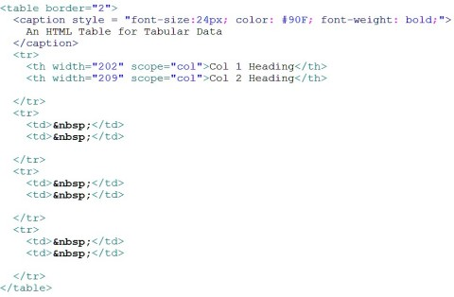
Table Code - I
Source: Google Images

Slide 63
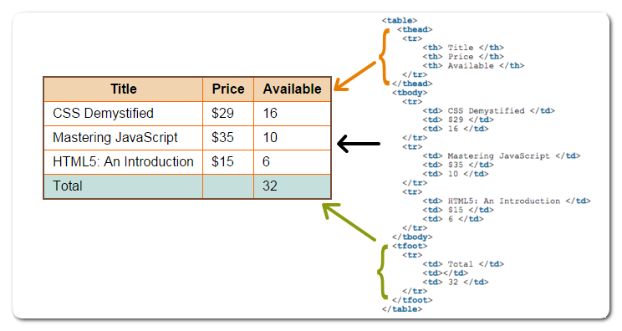
Table Code - II
Source: Fastwebstart

Slide 64
Tip!
Old browsers could not render the empty cells. Use the following html entity to avoid this problem:
&nbps;

Slide 65
TRY: Chrome Dev Tools
https://www.smashingmagazine.com/2008/08/top-10-css-table-designs/

Slide 66
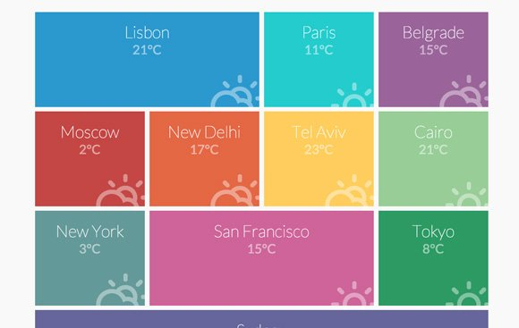
let’s try it

Slide 67
<!DOCTYPE html>
<html lang="de-CH">
<head>
<meta charset="UTF-8" />
<title>Form</title>
</head>
<body>
<table border="1" cellspacing="5" cellpadding="50">
<caption> Cities and Weather</caption>
<tr>
<td bgcolor="skyblue" colspan="2">Lisbon <br> 21<sup><small>o</small></sup>C</td>
<td bgcolor="aliceblue" >Paris <br> 11<sup><small>o</small></sup>C</td>
<td bgcolor="purple" >Belgrade <br> 15<sup><small>o</small></sup>C</td>
</tr>
<tr>
<td bgcolor="crimson" >Moskow <br> 2<sup><small>o</small></sup>C</td>
<td bgcolor="orange" >New Delhi <br> 17<sup><small>o</small></sup>C</td>
<td bgcolor="yellow" >Tel Aviv <br> 23<sup><small>o</small></sup>C</td>
<td bgcolor="khaki" >Cairo <br> 21<sup><small>o</small></sup>C</td>
</tr>
<tr>
<td bgcolor="gray" >New York <br> 3<sup><small>o</small></sup>C</td>
<td bgcolor="purple" colspan="2">San Francisco <br> 15<sup><small>o</small></sup>C</td>
<td bgcolor="darkgreen" >Tokyo <br> 8<sup><small>o</small></sup>C</td>
</tr>
<table>
</body>
</html>
Solution

Slide 68
Tags for Content Structuring
div (division)
span ()
fieldset
form
main
header
footer
nav
aside
article
section
details, summary
Layout
Tags for Grouping

Slide 69
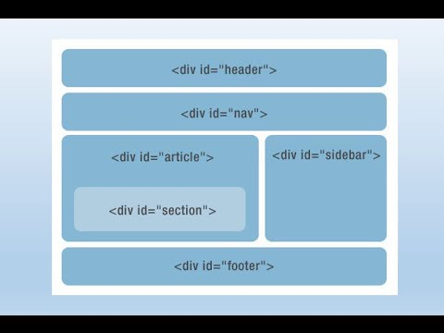
NON-Semantic HTML Tags
Source: Hongkiat

Slide 70
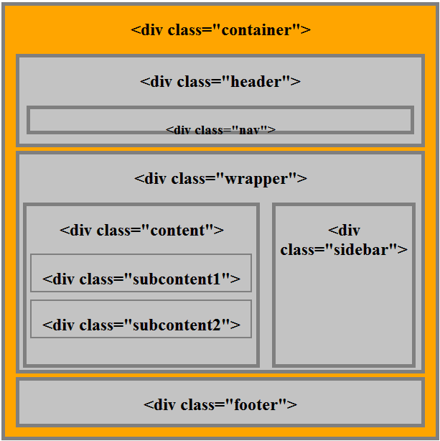
NON-Semantic HTML Tags
Source: C-sharpcorner

Slide 71
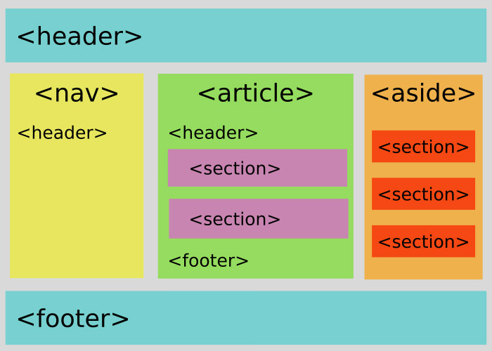
Semantic HTML Tags
Source: Hongkiat

Slide 72
TRY: Chrome Dev Tools
https://getbootstrap.com/docs/4.0/examples/album/

Slide 73
let’s try it
write it with divs convert it into semantic tags!

Slide 74
<!DOCTYPE html>
<html lang="de-CH">
<head>
<meta charset="UTF-8" />
<title>Semantic Layouting</title>
</head>
<body>
<main>
<header>
<nav>...nav..</nav>
</header>
<section>
<article>
<section>...subcontent1...</section>
<section>...subcontent2...</section>
</article>
<aside>...sidebar...</aside>
</section>
<footer>...footer...</footer>
</main>
</body>
</html>
Solution

Slide 75
Tip!
Use the following website to check the general availability of any web standard
https://caniuse.com

Slide 76
HTML
Attributes

Slide 77
Ein HTML Dokument (DOM Tree)

Slide 78

Attributes
Tags are html rendering commands
Each tag has its own set of attributes
Tags (appearance, behaviour) can be modified by attributes
Customize the Tag

Slide 79
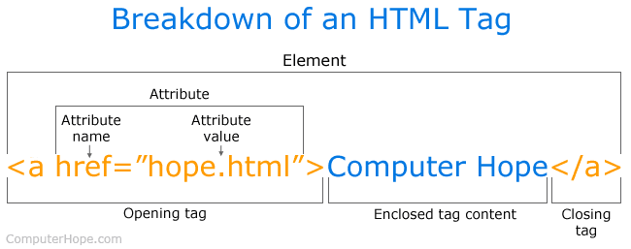
Beispiele

Slide 80
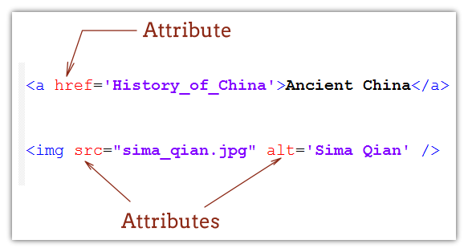
For example
href, src, alt

Slide 81
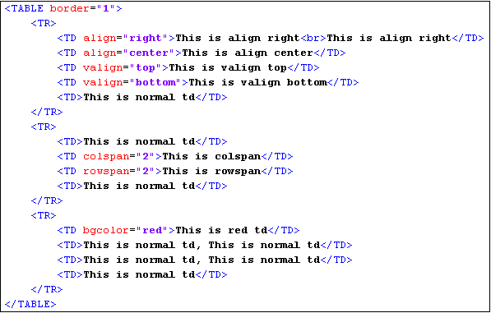
For example
align, valign, bgcolor, colspan, rowspan

Slide 82
Global
Attribute
Often used
id
class
title
style
data-*
hidden
lang
tabindex
Others
accesskey
contenteditable
contextmenu
dir
draggable
dropzone
itemid
itemprop
itemref
itemscope
itemtype
spellcheck
Applies to all HTML Tags (Elements)

Slide 83
let’s try it
Use the most used attributes on a “DIV” element.
And try to make this DIV element editable und de/activate spellcheck on this DIV element.

Slide 84
Tag specific Attributes
<img src=”/image.jpg” alt=”My Dogs Image”/>
sizes, srcset, height, width, crossorigin, ...
<a href=”http://abc.com” target=”_blank”>..</a>
download, ping, rel, type
<input type=”tel” autofocus=”true” autocomplete=”off”/>
pattern, placeholder, min, max, size, minlength, maxlength, name, readonly, required, spellcheck, value, ...
<button disabled=”true” >...</button>
audio
loop, autoplay, muted, played, buffered, src, preload, volume, controls
meter
min, max, low, high, optimum, value
progress
max, value
form
novalidate, target, action, method, enctype, autocomplete, accept-charset, …
details
open
textarea
cols, rows, wrap
td
bgcolor, rowspan, colspan, valign, align, ...
More Information:
https://developer.mozilla.org/en-US/docs/Web/HTML/Attributes

Slide 85
let’s try it
Create four links with 2 target names.
Use target 1 for the first two links and the other one for the rest.
Create an “IMG” tag with Abraxas logo and add “alt” attribute. Then change the image url to a non-existing resource url.
Create an input element (email) with “autofocus” enabled.
Create a read only input element
Create a disabled input element.
Create an unordered list with a different bullet type
Change the jump order (tab) of the link & input elements

Slide 86
<!DOCTYPE html>
<html lang="de-CH">
<head>
<meta charset="UTF-8" />
<title>Input Elements</title>
</head>
<body>
<main>
<a href="http://gmail.com" target="one" tabindex="9">gmail.com</a>
<a href="http://twitter.com" target="one" tabindex="1">twitter.com</a>
<a href="http://facebook.com" target="two" tabindex="5">facebook.com</a>
<a href="http://instagram.com" target="two" tabindex="-1">instagram.com</a>
<br><br>
<img src="https://img.com/img.jpg" alt="Abraxas Logo war wirklich hier! Ich schörrrrr"/>
<br><br>
<input type="text" autofocus value="focused" tabindex="-100"/> <br>
<input type="text" disabled value="disabled" tabindex="4"/> <br>
<input type="text" readonly value="readonly" tabindex="2"/>
<br><br>
<ul type="square">
<li>one</li>
<li>two</li>
</ul>
</main>
</body>
</html>
Solution

Slide 87
Tip!
You can use your own attributes name.

Slide 88
Attributes
for Javascript
Alle Attribute, die mit dem Präfix “on” anfangen.
Sie werden auch Event Attributes genannt.
Es gibt globale und auch tag spezifische Events. Beispiele:
onclick
onmouseover
onload
onhashchange
onafterprint
onoffline
onfocus
onpageshow
onsubmit
onwheel
ondragend
onscroll
oncopy/onpaste
onplay/onwaiting
...
Mehr Informationen unter
https://www.w3schools.com/tags/ref_eventattributes.asp

Slide 89

Attributes
for CSS
style
<h1 style="color:blue;">This is a Blue Heading</h1>
also called Inline Style
directly inside HTML - Tag
binds structure and design together
generally a Bad Practice
has a higher Priority
ie. Inline Style is preferred over External Style (separate file) / Internal Style (<style> </ style> tag)
More on CSS Priorities in CSS Part of the course

Slide 90
let’s try it
Use some Style & Structure attributes in one HTML.

Slide 91
Tip!
Do not use ever never inline css and javascript!

Slide 92
Other Goodies

Slide 93

HTML Entities
&entity_name;
&#entity_no;
< = &lt; oder &#60;
> = &gt; oder &#62;
💩 = &#128169;
😉 = &#128521;
= &#128584;
♞ = &#9822;
Spezielle Zeichenfolgen im Dokument. Mehr Informationen und Beispiele:
http://html-css-js.com/html/character-codes/html4/

Slide 94
let’s try it
Create a small set of known emojis by using a table.

Slide 95
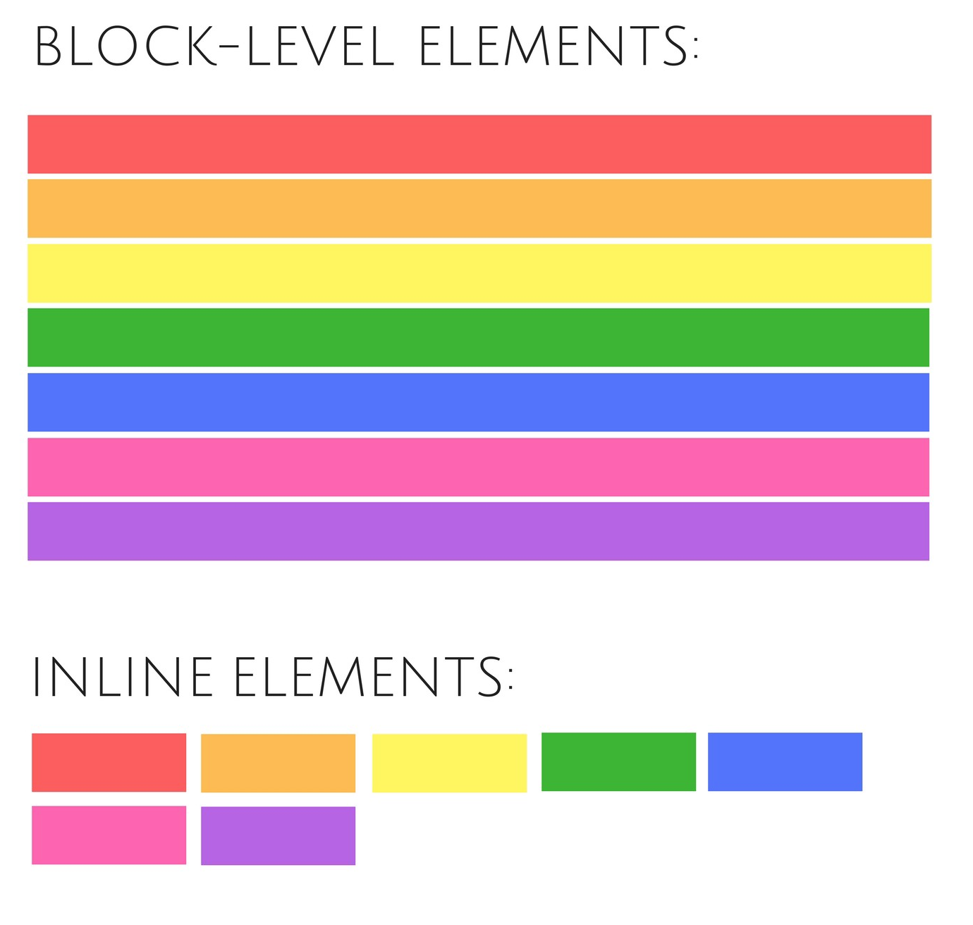
Inline, Block Tags (Elements)
Elements can also be classified differently
https://marksheet.io/html-block-inline.html
Inline: Dostunu ötelemeyen tag

Slide 96
Micro Data
HTML5 Microdata is a new microformats added in HTML5 which is used to describe the meaning of the information in a suitable form for the search engine
hCard – Markup format contact information (address, phone, and so on. d.);
hRecipe – Format to describe the recipes;
hReview – Reviews markup format;
hProduct – Markup format products.
Blogs
News
https://www.w3.org/TR/microdata/

Slide 97
<article itemscope itemtype = "http://schema.org/article">
<h1 itemprop = "headline"> About Microdata</ ​h1>
<section itemprop = "text">
This is demo content!!!
</ section>
<section itemscope itemprop = "author" itmetype ="http://schema.org/Person">
<span itemprop = "author"> Bhumi </span>
</ section>
</ article>
Microdata Example
Source: http://www.thecreativedev.com/how-to-use-microdata-in-html5/

Slide 98
Micro Data
ATTRIBUTES
Attribute Name: Attribute value
itemscope : It is an attribute with boolean type and creates Microdata block. It is a key attribute microdata and specify the contents of the HTML element in a single structure.
itemtype : It is an attribute used to define the type of data item for a particular Microdata block (itemscope). It is a type of structure and value is in the form URL.
itemprop : It is an attribute element defines a property of the data for declared type.
itemid : It is an attribute assigns a global unique identifier to a micro element.
itemref : It is an attribute that refers to associate a data block ID.
https://www.w3.org/TR/microdata/

Slide 99
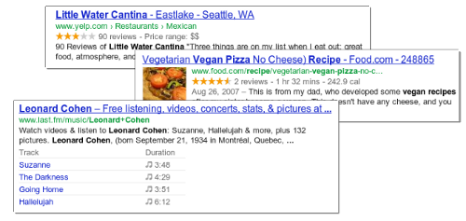
MicroData is the basic requirements of the google rich snippets

Slide 100
SVG
The SVG element can be used to draw various shapes on a web page since these are vector based
Scalable Vector Graphics

Slide 101
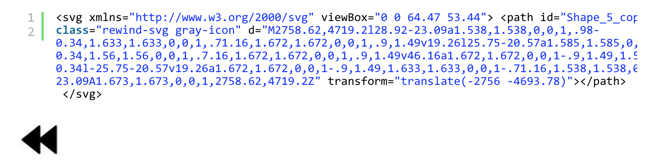
An Arrow drawn by SVG
Source: http://www.tothenew.com/blog/advanced-features-of-html5-and-css3/

Slide 102
Conditional
Comments
Conditional comments, which are nothing more than simple HTML comments that IE (up to version 9) happens to take a peep at, are used to throw a chunk of HTML at these browsers and only these browsers.
<!--[if IE]>
<link href="stupidie.css" rel="stylesheet">
<![endif]-->
Notes:
Other well behaved, top-of-the-class browsers will simply see them as unremarkable comments and move along.

Slide 103
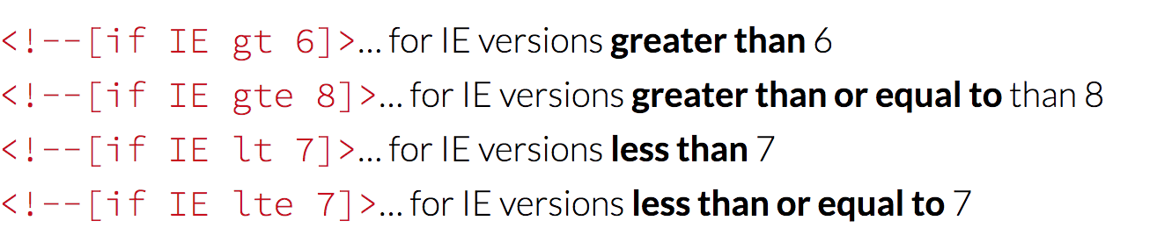
Conditional
Comments
Notes:
Other well behaved, top-of-the-class browsers will simply see them as unremarkable comments and move along.

Slide 104
CANVAS
Element
It is designed to provide a canvas onto which JavaScript can be used to paint all manner of dynamic images such as graphs, animated sprites, or daft cat pictures.
https://developer.mozilla.org/kab/docs/Web/API/Canvas_API
Notes:
Other well behaved, top-of-the-class browsers will simply see them as unremarkable comments and move along.

Slide 105

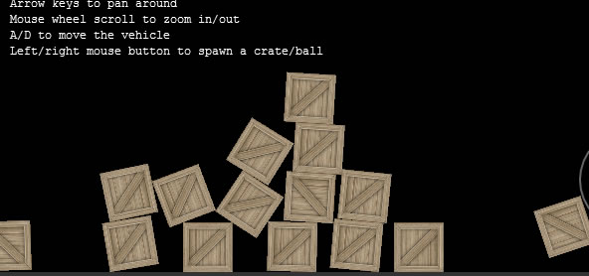
CANVAS
Element
https://developer.mozilla.org/kab/docs/Web/API/Canvas_API
Notes:
Other well behaved, top-of-the-class browsers will simply see them as unremarkable comments and move along.

Slide 106
Tip!
Use the following web site for your needs in finding icons.
https://www.iconfinder.com/

Slide 107
let’s try it
Create a profile page

Slide 108
<!DOCTYPE html>
<html lang="de-CH">
<head>
<meta charset="UTF-8" />
<title>Profile</title>
</head>
<body>
<main>
<section>
<aside>
<figure>
<img src="" alt="My Photo" />
<figcaption>Fig.1 - Mehmet Dogan</figcaption>
</figure>
</aside>
<section>
<fieldset>
<legend> Personalien </legend>
<ol>
<li>Mehmet Dogan</li>
<li>Email: mehmet.dogan@abraxas.ch</li>
<li>Telefon: +41 76 399 17 80</li>
<li>...</li>
</ol>
</fieldset>
<fieldset>
<legend> Ausbildung </legend>
<table>
<tr>
<th>Name</th>
<th>Von</th>
<th>Bis</th>
</tr>
<tr>
<td>University of Liverpool, UK</td>
<td>2013</td>
<td>2016</td>
</tr>
<tr>
<td>DEU, TR</td>
<td>1998</td>
<td>2004</td>
</tr>
</table>
</fieldset>
<fieldset>
<legend> Hobbies </legend>
<ul>
<li>..</li>
<li>..</li>
<li>..</li>
</ul>
</fieldset>
</section>
</section>
</main>
</body>
</html>
Solution

Slide 109
Fragen?

